Slide 1

提升教师数学技能有助于提高学生成绩
Represented by Zhan Changming

Slide 2

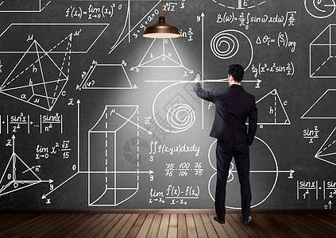
Many elementary school teachers say they
dislike the idea of teaching mathematics even at the most basic level.
That is a cause for concern among educators.
Experts say it is critical for students to have a solid foundation in the subject because math skills build on each other.
Research published by the National Institutes of Health (NIH) found that math is a common cause
of anxiety for adults, especially for women. About 90 percent of elementary teachers in the U.S. are women.
The NIH study suggested that, in the field of education, anxiety can have a harmful effect on learners.

Slide 3

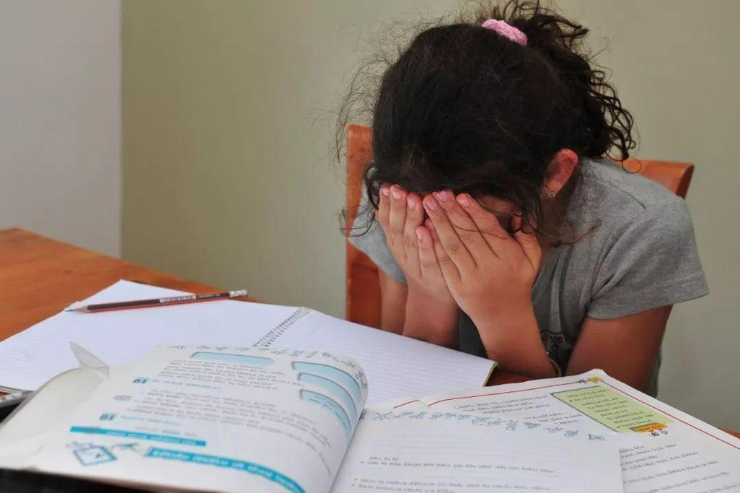
International studies have found that U.S.
students are behind many other democracies in math skills.
In 2017, the OECD, an international economic research group, ranked the U.S. 30th among member countries.
Since the worldwide COVID19 pandemic, the math test scores in the U.S. suffered even more.
Educators now say an important step to
improving math skills after the pandemic is to
increase the confidence of elementary school
teachers.
The Erikson Institute in Chicago is a graduate school centered on child development.
The school holds a yearly math conference where elementary teachers can ease their anxiety about math.

Slide 4
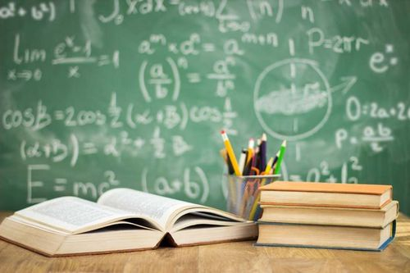


Teachers find out how young children learn math and plan activities for the classroom.
Jennifer McCray is a research professor at Erikson.
She said the best way to see how a child will perform in math up through eighth grade is to learn how the child did in math when they started kindergarten.
Teachers are worried that they will transfer their math fears to their students.
Math specialists say this is a persistent issue in elementary school classrooms.
Elementary school teachers are expected to teach every subject, often leading them to spend less classroom time on math.
During the Erikson Institute's summer meeting, teachers work with math concepts that they can use in the classroom.

Slide 5


For example, the group built 10-sided shapes out of colored blocks.
These exercises helped the teachers with their own math skills.
Lauran Solarski is a trainer with the Early Math Collaborative at Erikson.
She told a group of educators, "There's a misbelief that in order to teach early childhood math, you don't really need to know math well."
Lisa Ginet is the director of opera-tions at Erikson.
She said that early childhood teachers do not necessarily need to be experts in complex math subjects like algebra and geometry.

Slide 6

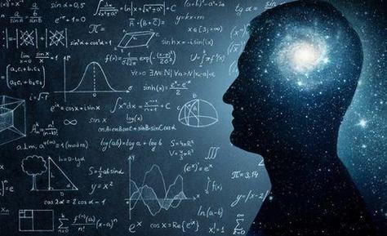

But they need to understand that many of the skills they are teaching are connected to mathematical thinking and to subjects that students will learn later in school.
Stacey Stevens works for the Kentucky Department of Education as the director of early childhood education training center.
She said she changed her study major in college to early childhood education to avoid high level math.
After she completed a yearlong class in math to improve her teaching, she finally started to understand how to teach the subject.
Stevens said she was passionate about teaching preschool because she did not want children to have the same struggles in math that she had growing up.

Slide 7

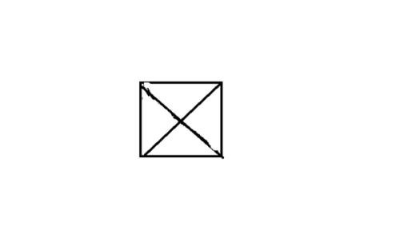

"I wanted them to understand that four triangles make a square: to actually see it and do it and not just be told that a triangle is a fourth of a square.“
Heather Peske is the president of the National Council on Teacher Quality (NCTQ), a research group based in Washington, D.C.
She said colleges need to better prepare teachers to teach math before they get into the classroom.
The NCTQ studied teacher preparation programs in 2022.
It found that most do not spend as much time on elementary math content as NCTQ thinks is necessary.
The recommendations were based on studies that linked student achievement to teacher's math studies in college.

Slide 8



Peske said,"If we prepared them better, they would be stronger at both their math knowledge as well as their ability to teach math, and this would reduce their anxiety and improve student outcomes."

Slide 9



